Slide 1
Опухолевые органоиды - история, применение и опыт научной группы
Международная лаборатория микрофизиологических систем
Москва
2024
с.н.с., доц., к.б.н. Никулин С.В.

Slide 2
YouTube
Hans Clevers (Hubrecht I., UU) 1: Discovery and Characterization of Adult Stem Cells in the Gut
Hans Clevers (Hubrecht I., UU) 2: Generating Epithelial Organoids from Adult Tissue
Hans Clevers (Hubrecht I., UU) 3: Organoid Technology for Disease Modeling

Slide 3
Взрослые стволовые клетки кишки

Slide 4
Gut stem cells
Nick Barker
Hans Clevers

Slide 5
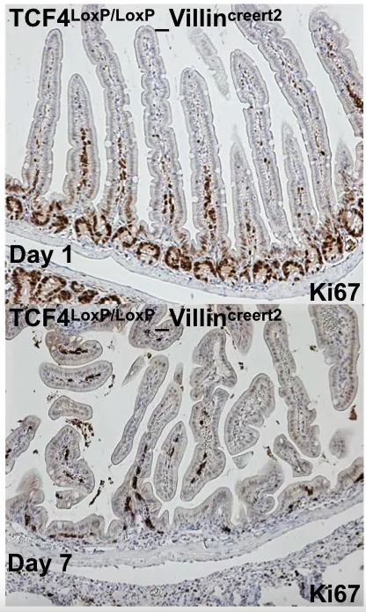
Wnt signaling
van Es J. H. et al. A critical role for the Wnt effector Tcf4 in adult intestinal homeostatic self-renewal //Molecular and cellular biology. – 2012. – Т. 32. – №. 10. – С. 1918-1927.

Slide 6
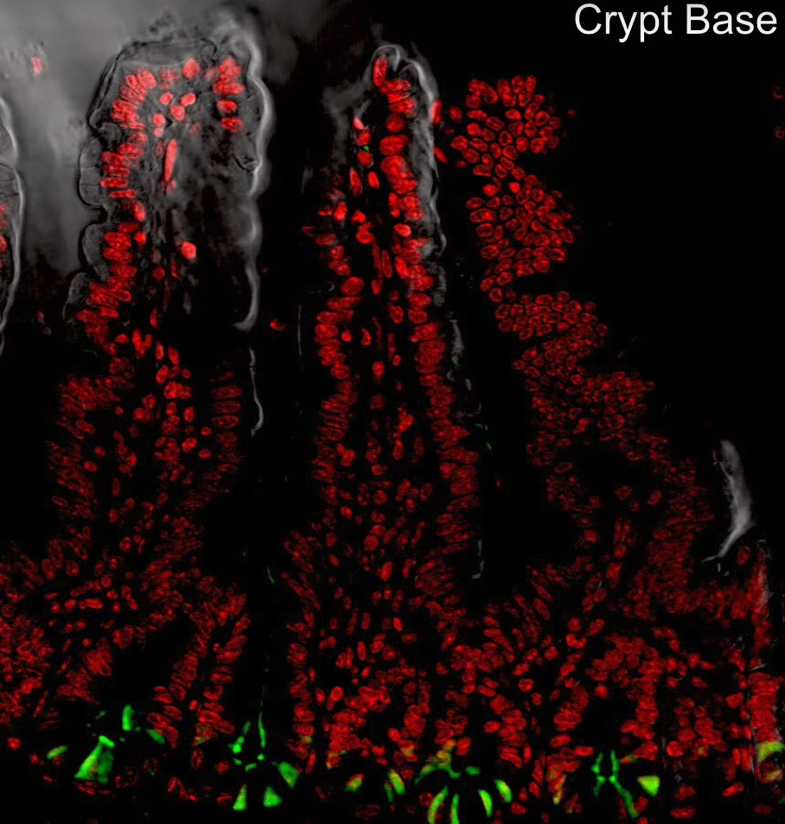
Lgr5
Barker N. et al. Identification of stem cells in small intestine and colon by marker gene Lgr5 //Nature. – 2007. – Т. 449. – №. 7165. – С. 1003-1007.

Slide 7
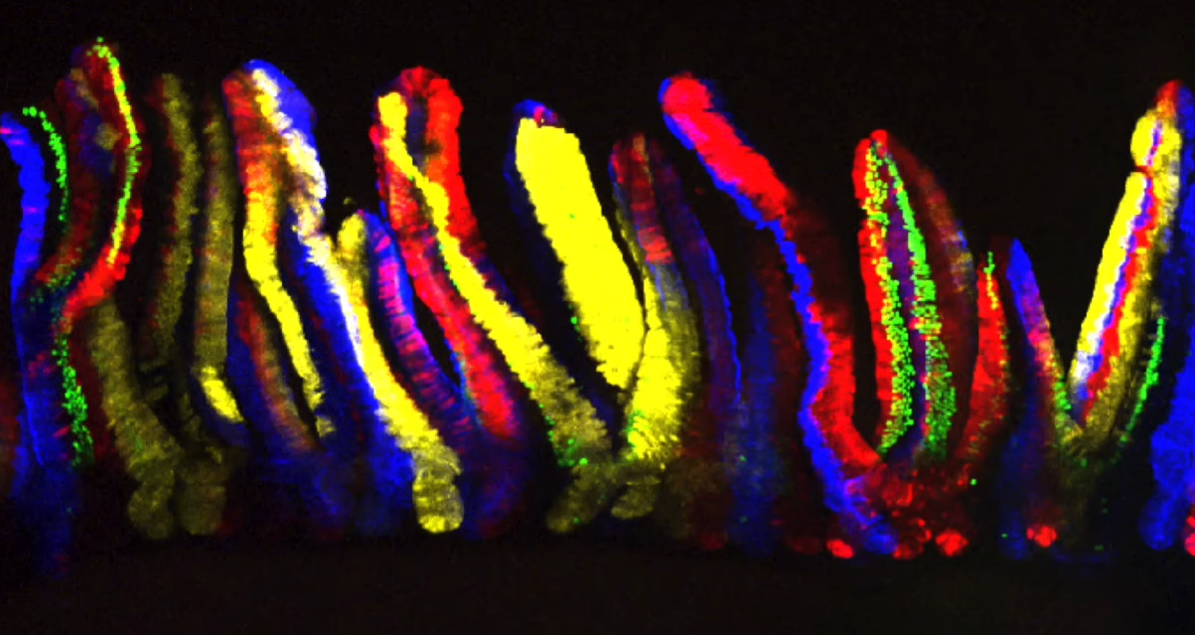
Progenitor mark
Snippert H. J. et al. Intestinal crypt homeostasis results from neutral competition between symmetrically dividing Lgr5 stem cells //Cell. – 2010. – Т. 143. – №. 1. – С. 134-144.

Slide 8
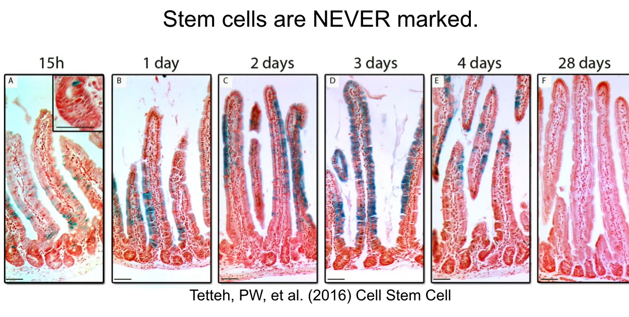
Gut stem cells
Tetteh P. W. et al. Replacement of lost Lgr5-positive stem cells through plasticity of their enterocyte-lineage daughters //Cell stem cell. – 2016. – Т. 18. – №. 2. – С. 203-213.

Slide 9
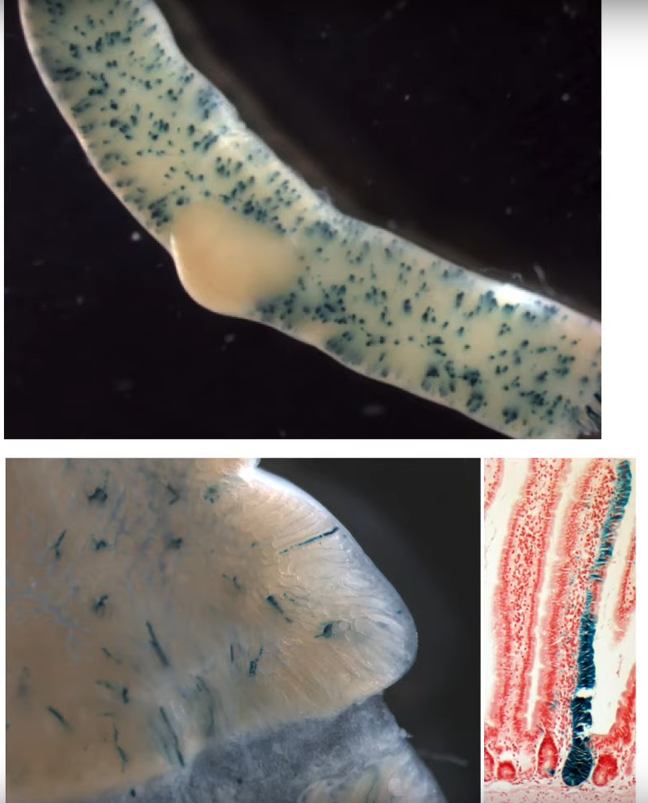
After remove of all Lgr5+ cells
Tetteh P. W. et al. Replacement of lost Lgr5-positive stem cells through plasticity of their enterocyte-lineage daughters //Cell stem cell. – 2016. – Т. 18. – №. 2. – С. 203-213.

Slide 10
Органоиды

Slide 12
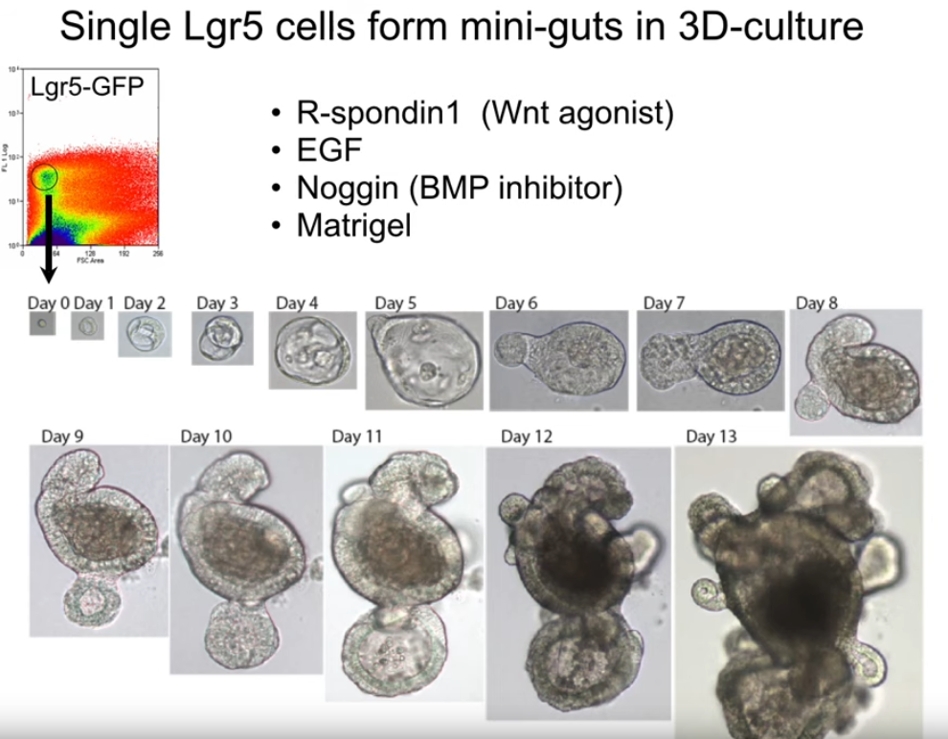
Sato T. et al. Single Lgr5 stem cells build crypt-villus structures in vitro without a mesenchymal niche //Nature. – 2009. – Т. 459. – №. 7244. – С. 262-265.

Slide 13
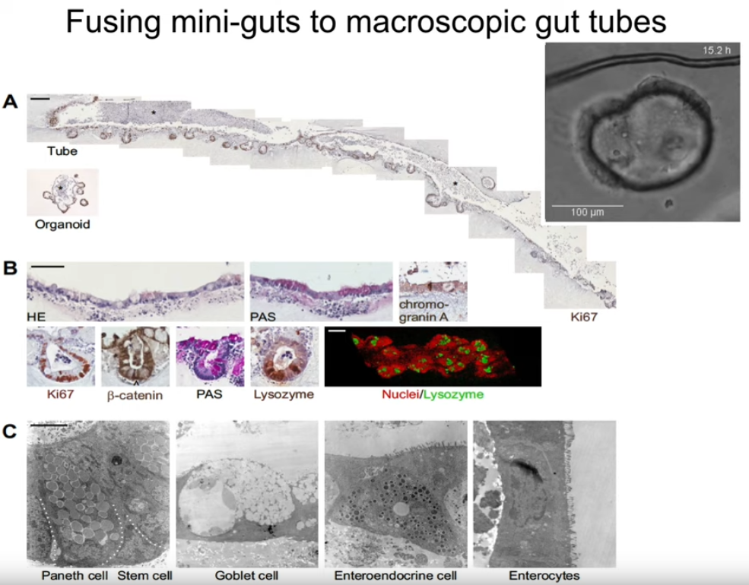
Sachs N. et al. Intestinal epithelial organoids fuse to form self-organizing tubes in floating collagen gels //Development. – 2017. – Т. 144. – №. 6. – С. 1107-1112.

Slide 14
Yui S. et al. Functional engraftment of colon epithelium expanded in vitro from a single adult Lgr5+ stem cell //Nature medicine. – 2012. – Т. 18. – №. 4. – С. 618-623.

Slide 15
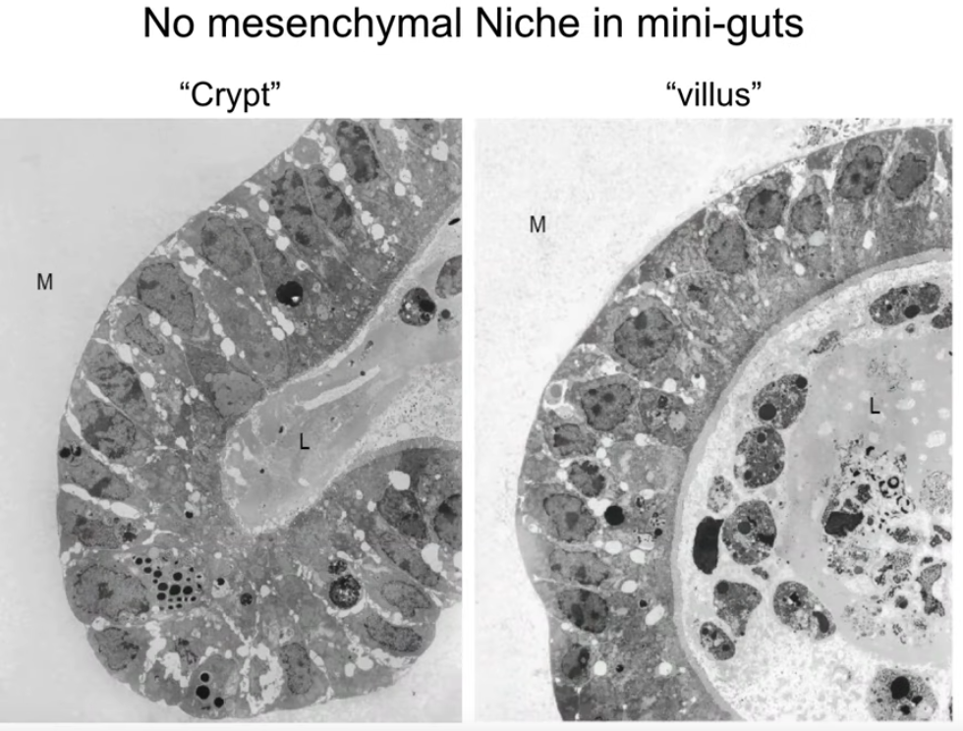
Sato T. et al. Single Lgr5 stem cells build crypt-villus structures in vitro without a mesenchymal niche //Nature. – 2009. – Т. 459. – №. 7244. – С. 262-265.

Slide 16
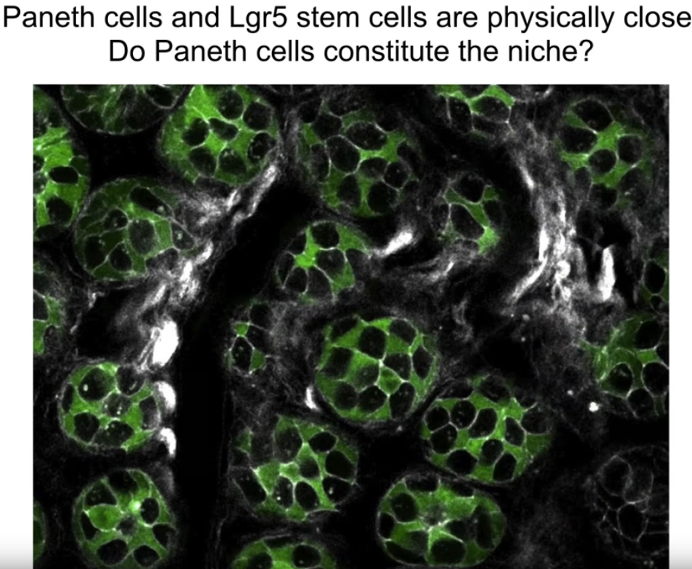
Sato T. et al. Paneth cells constitute the niche for Lgr5 stem cells in intestinal crypts //Nature. – 2011. – Т. 469. – №. 7330. – С. 415-418.

Slide 17
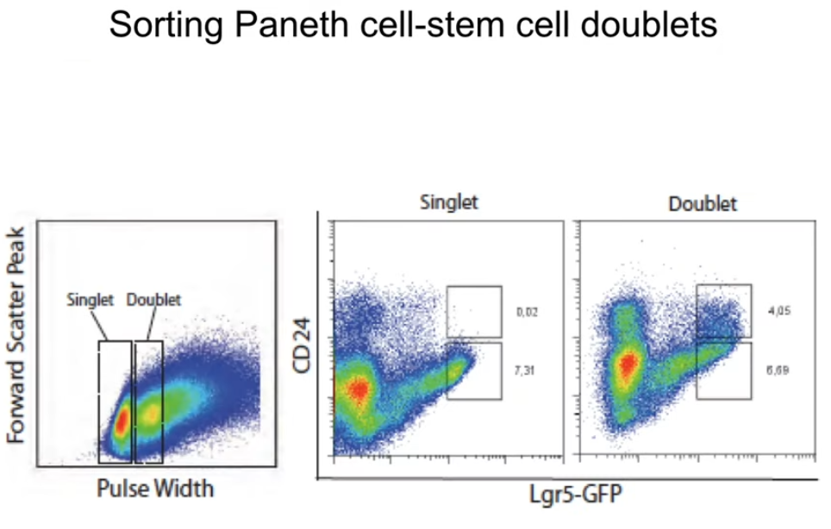
Sato T. et al. Paneth cells constitute the niche for Lgr5 stem cells in intestinal crypts //Nature. – 2011. – Т. 469. – №. 7330. – С. 415-418.

Slide 18
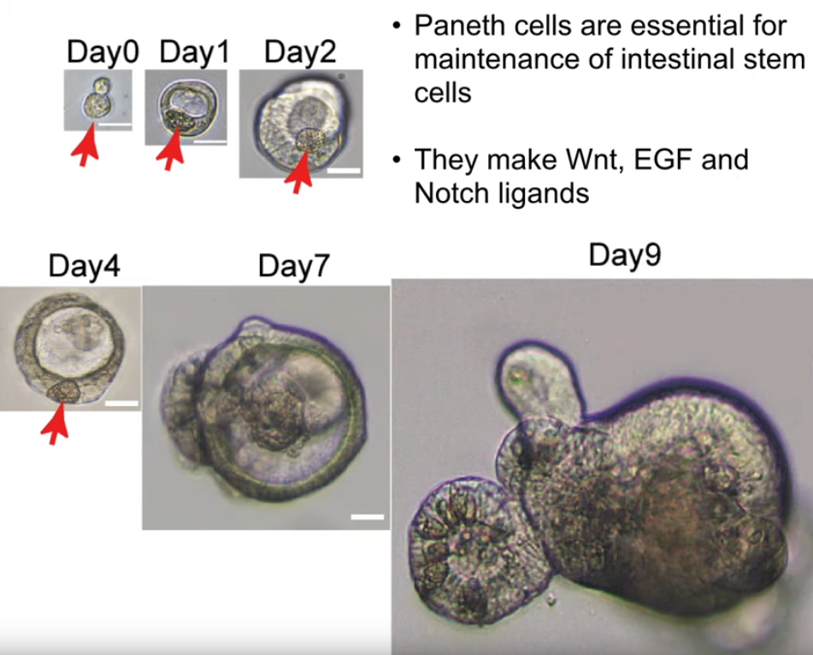
Sato T. et al. Paneth cells constitute the niche for Lgr5 stem cells in intestinal crypts //Nature. – 2011. – Т. 469. – №. 7330. – С. 415-418.

Slide 19
Sato T. et al. Paneth cells constitute the niche for Lgr5 stem cells in intestinal crypts //Nature. – 2011. – Т. 469. – №. 7330. – С. 415-418.

Slide 20
Опухолевые органоиды

Slide 21
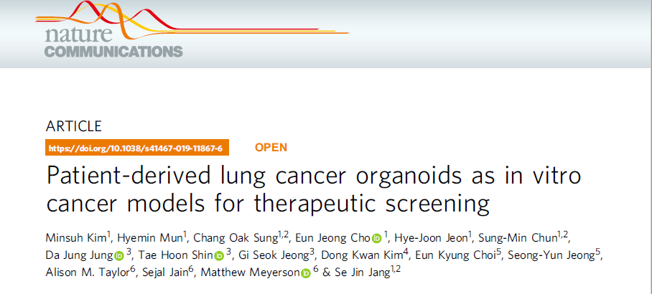
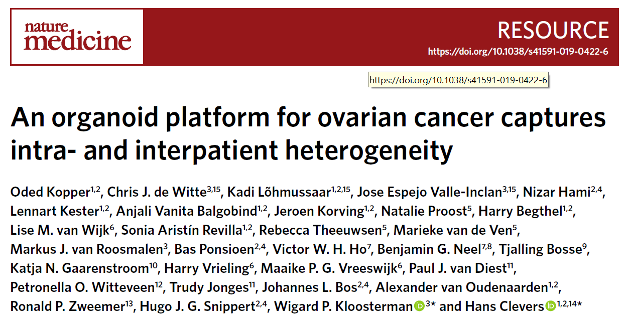
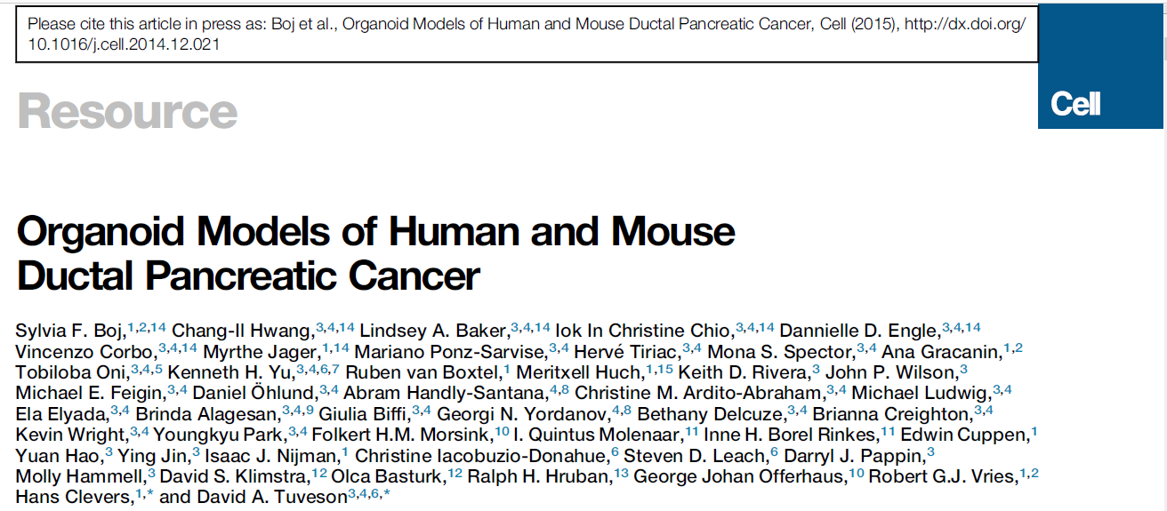

Slide 22
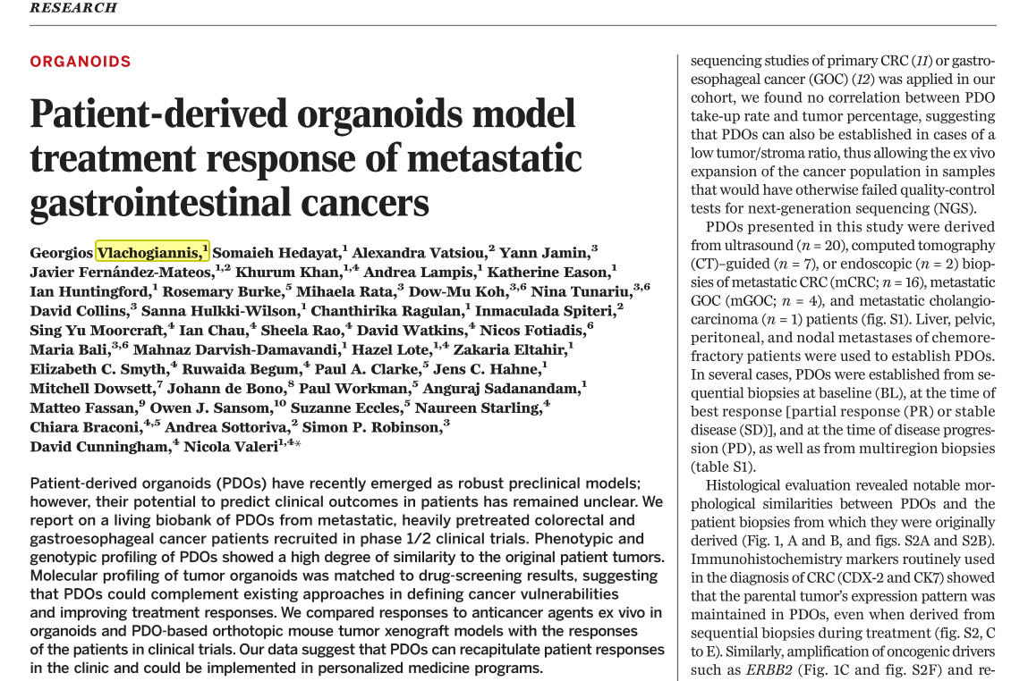
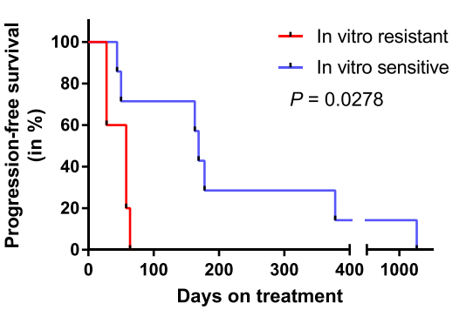
 |  | Response in the Clinic
 |  | R | NR
Ex Vivo Sensitivity | S | 7 | 1* | 8
 | NS | 0 | 13 | 10
 |  | 7 | 14 | 21

Slide 23
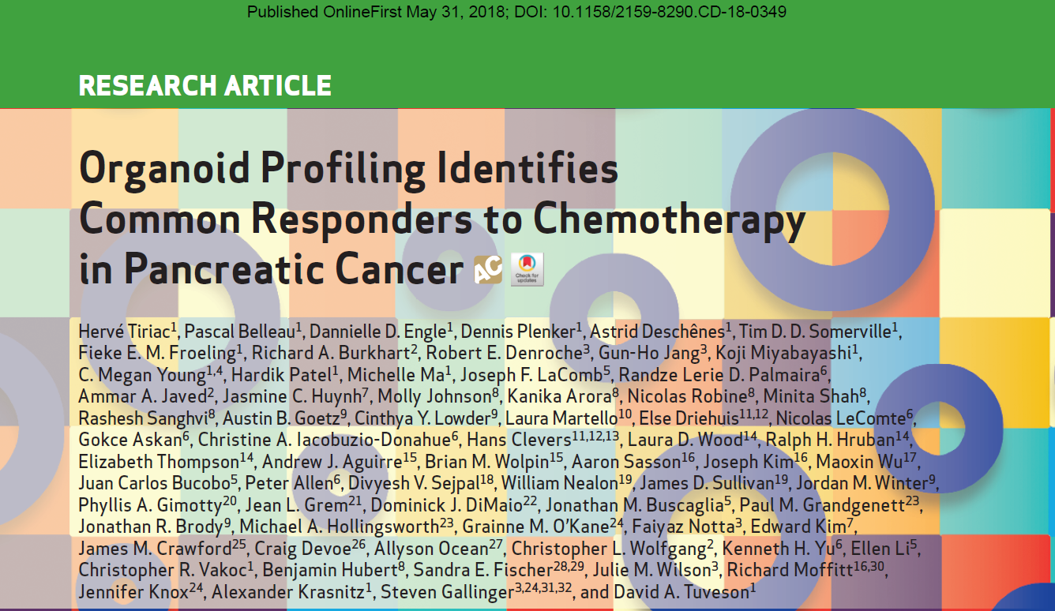
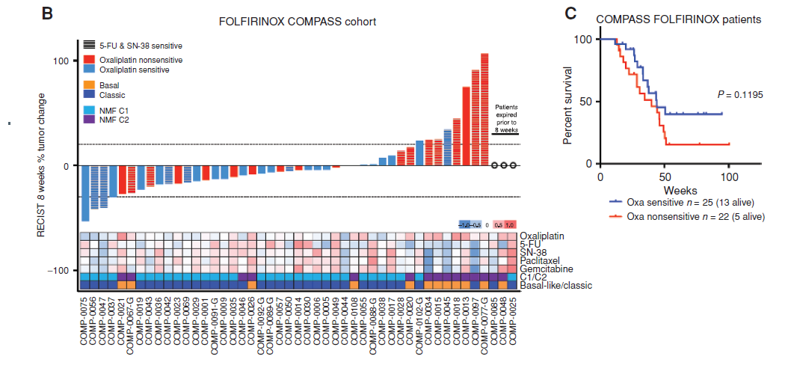

Slide 24
Clinical trials submitted
Drug Screening of Pancreatic Cancer Organoids Developed From EUS-FNA Guided Biopsy Tissues
Nanjing Drum Tower Hospital the Affiliated Hospital of Nanjing University Medical SchoolFemale
2018-2020
NCT03544255
Patient-derived Organoids of Lung Cancer to Test Drug Response
University Hospital, Geneva
2021-2024
NCT03979170
Novel 3D Myeloma Organoid to Study Disease Biology and Chemosensitivity (Organoid)
Wake Forest University Health Sciences & NCI
2019-2021
NCT03890614
Patient-derived Organoid Model and Circulating Tumor Cells for Treatment Response of Lung Cancer
The University of Texas Health Science Center at San Antonio
2018-2020
NCT03655015

Slide 25
Наш опыт

Slide 26
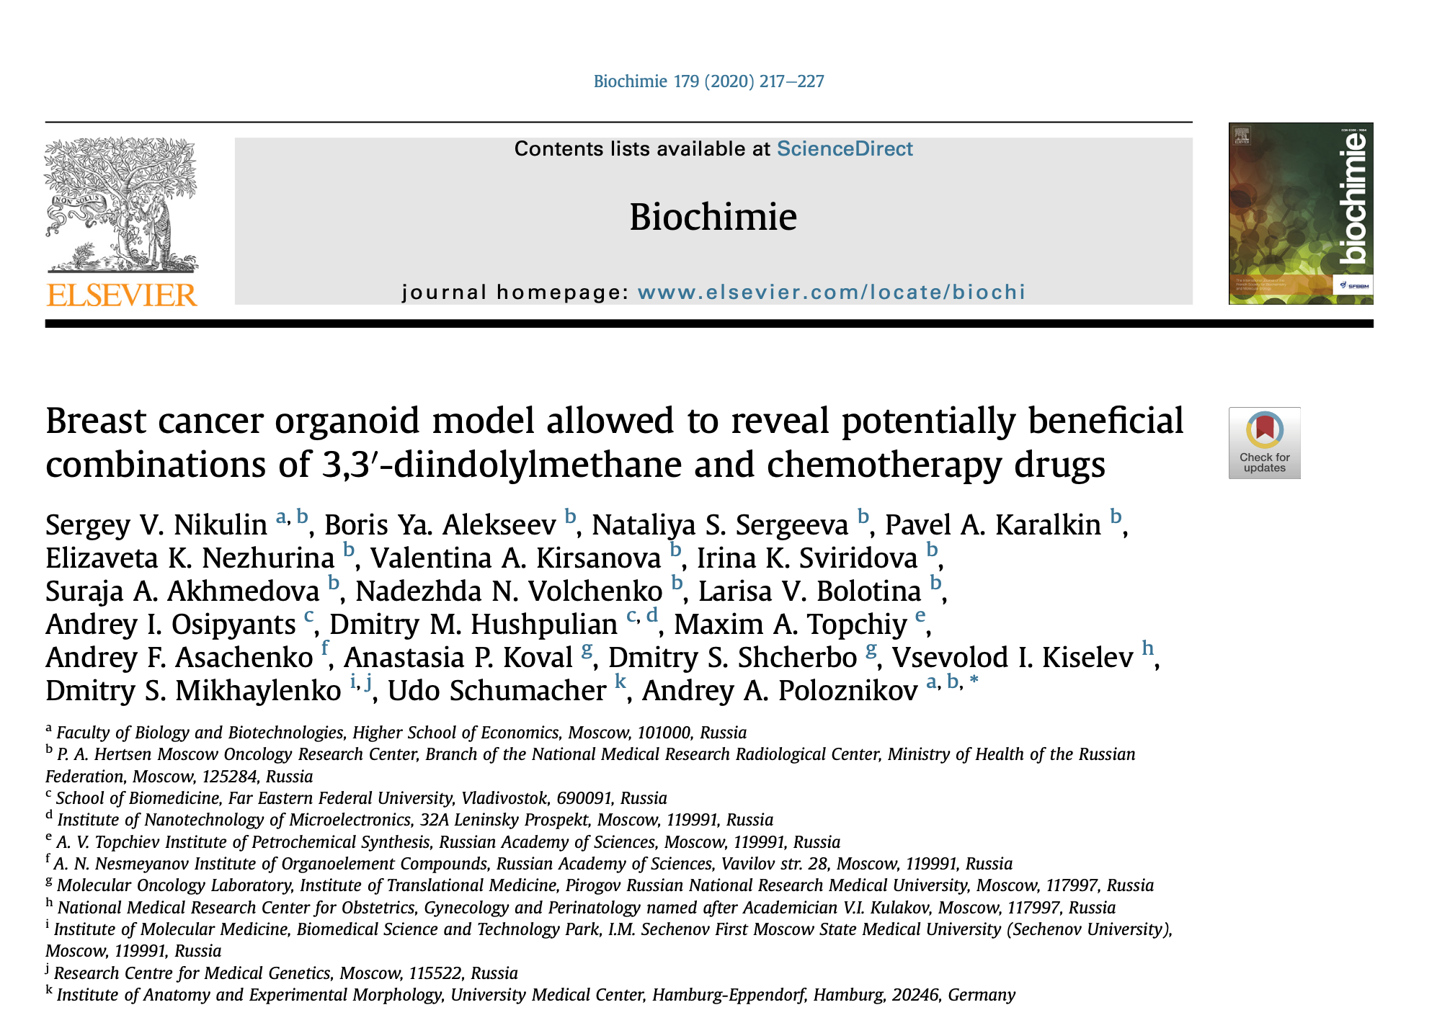

Slide 27
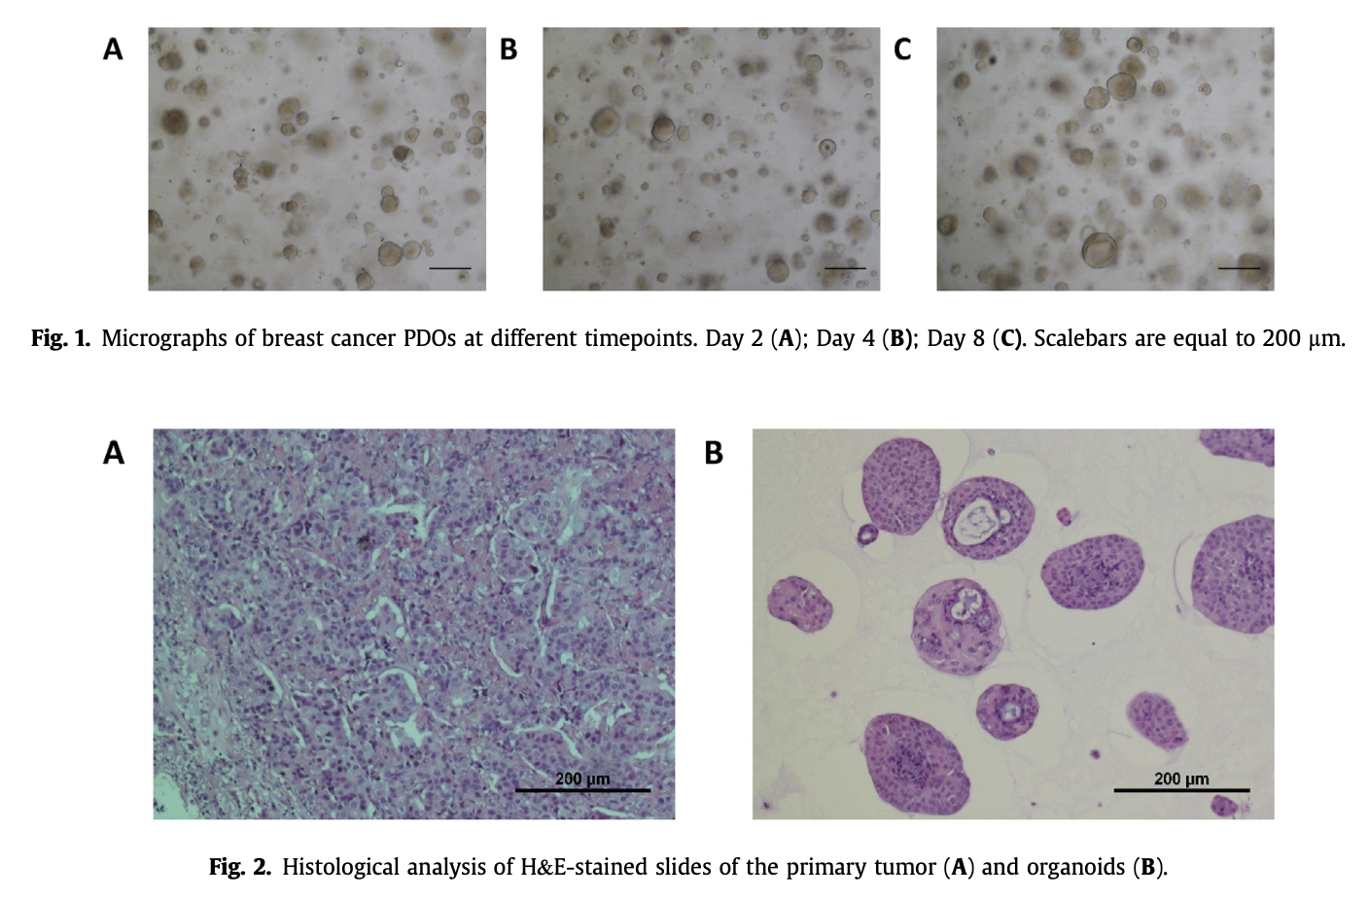

Slide 30
Спасибо за внимание!
Москва, 2024 год

