Slide 1

Органоиды в современной биологии и медицине
Никулин Сергей Вячеславович, к.б.н.

Slide 2
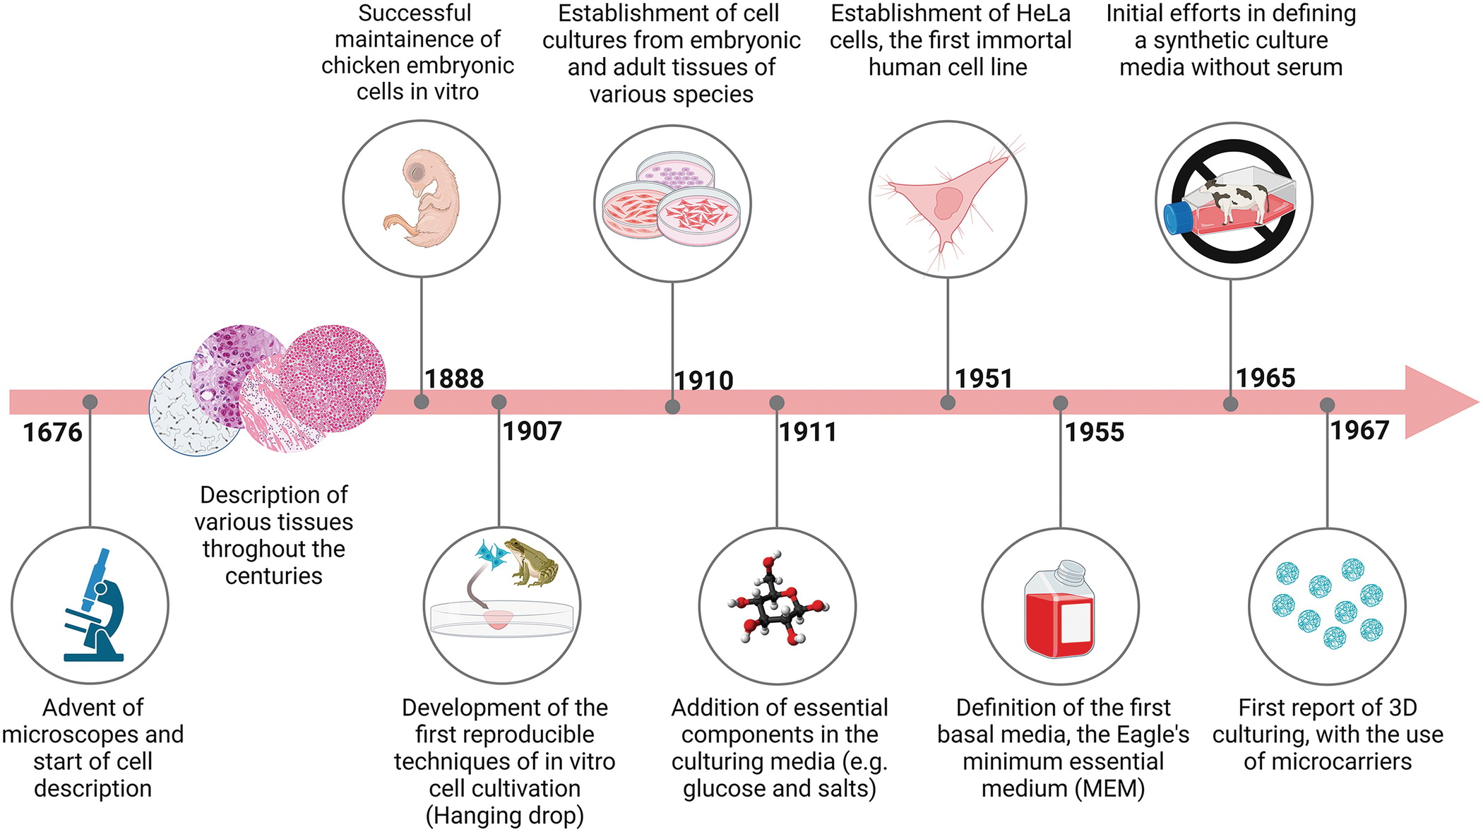
Культивирование клеток
Soccol, Carlos Ricardo, et al. "Introduction to Animal Cell Culture." Cultivated Meat: Technologies, Commercialization and Challenges. Cham: Springer Nature Switzerland, 2024. 7-27.

Slide 3
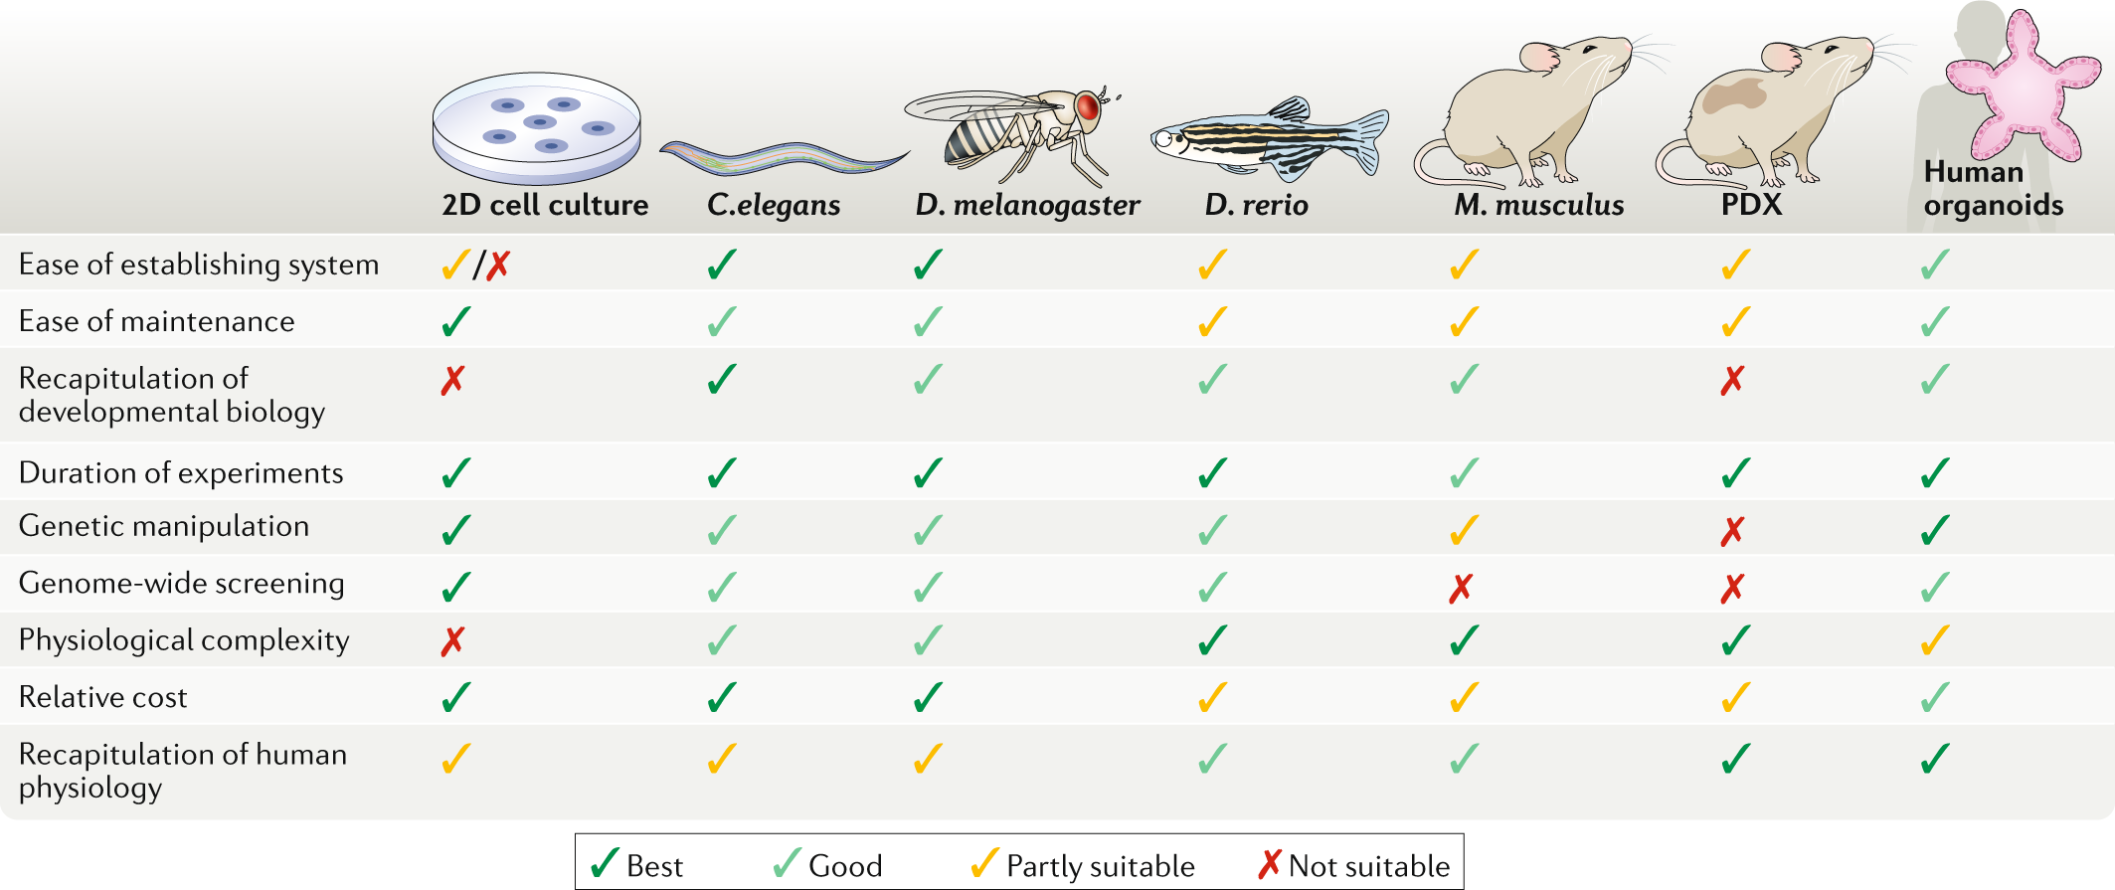
Сравнение модельных систем
Kim, Jihoon, Bon-Kyoung Koo, and Juergen A. Knoblich. "Human organoids: model systems for human biology and medicine." Nature reviews Molecular cell biology 21.10 (2020): 571-584.

Slide 4
Сравнение модельных систем
Kim, Jihoon, Bon-Kyoung Koo, and Juergen A. Knoblich. "Human organoids: model systems for human biology and medicine." Nature reviews Molecular cell biology 21.10 (2020): 571-584.

Slide 5
Что такое органоиды?
… an organoid is now defined as a 3D structure grown from stem cells and consisting of organ-specific cell types that self-organizes through cell sorting and spatially restricted lineage commitment …
Clevers, Hans. "Modeling development and disease with organoids." Cell 165.7 (2016): 1586-1597.
The modern term organoid refers to cells growing in a defined three-dimensional (3D) environment in vitro to form mini-clusters of cells that self-organize and differentiate into functional cell types, recapitulating the structure and function of an organ in vivo (hence, also called “mini-organs”).
Corrò, Claudia, Laura Novellasdemunt, and Vivian SW Li. "A brief history of organoids." American Journal of Physiology-Cell Physiology 319.1 (2020): C151-C165.
An organoid is a self-organized 3D tissue that is typically derived from stem cells (pluripotent, fetal or adult), and which mimics the key functional, structural and biological complexity of an organ.
Zhao, Zixuan, et al. "Organoids." Nature Reviews Methods Primers 2.1 (2022): 94.
Органоиды — это культивируемые in vitro, полученные из стволовых клеток, трехмерные самоорганизующиеся структуры, которые воспроизводят ключевые аспекты органов in vivo.

Slide 6
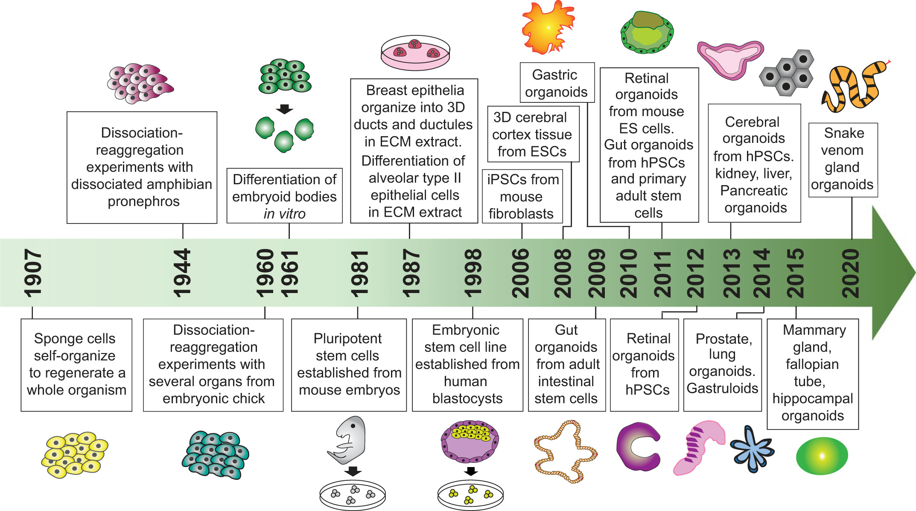
История органоидов
Corrò, Claudia, Laura Novellasdemunt, and Vivian SW Li. "A brief history of organoids." American Journal of Physiology-Cell Physiology 319.1 (2020): C151-C165.

Slide 7
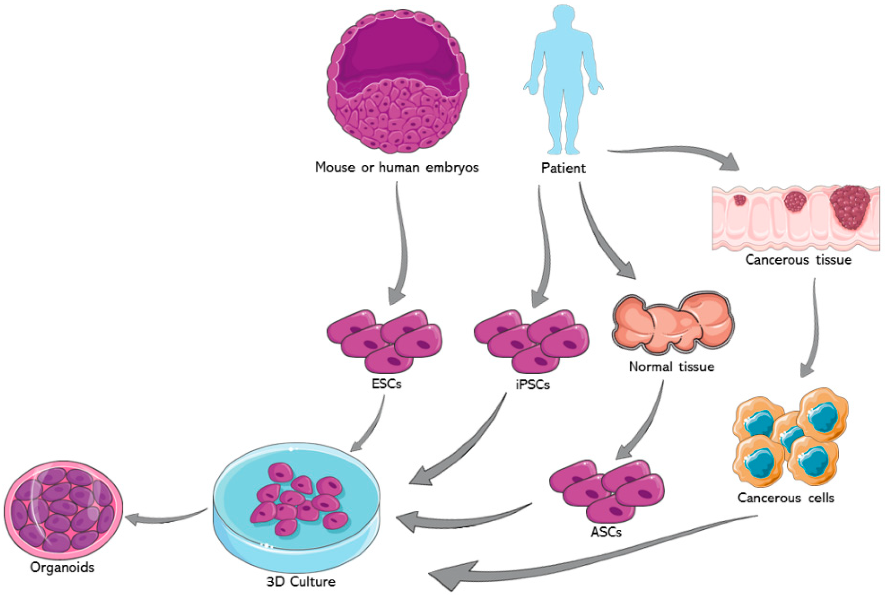
Источники получения органоидов
Azar, Joseph, et al. "The use of stem cell-derived organoids in disease modeling: an update." International Journal of Molecular Sciences 22.14 (2021): 7667.

Slide 8
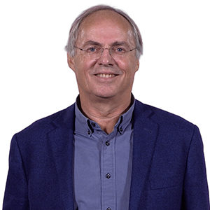
Органоиды из взрослых стволовых клеток
Hans Clevers (Hubrecht I., UU) 1: Discovery and Characterization of Adult Stem Cells in the Gut
Hans Clevers (Hubrecht I., UU) 2: Generating Epithelial Organoids from Adult Tissue
Hans Clevers (Hubrecht I., UU) 3: Organoid Technology for Disease Modeling
Hans Clevers

Slide 9
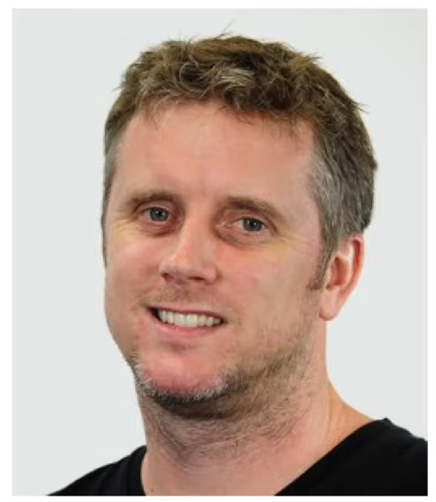
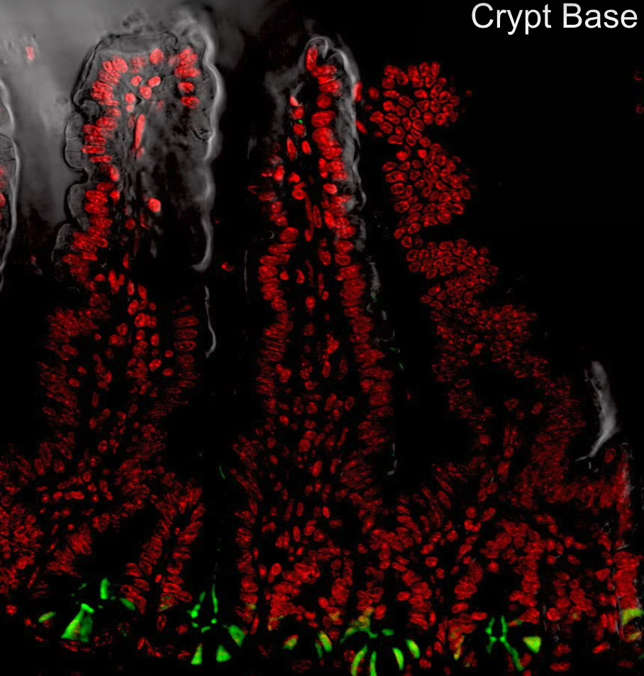
Стволовые клетки тонкой кишки
Nick Barker
Barker N. et al. Identification of stem cells in small intestine and colon by marker gene Lgr5 //Nature. – 2007. – Т. 449. – №. 7165. – С. 1003-1007.

Slide 10
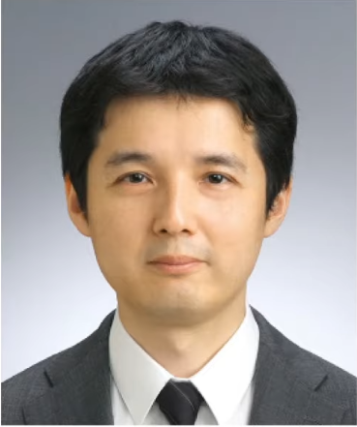
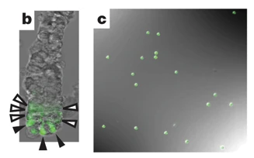
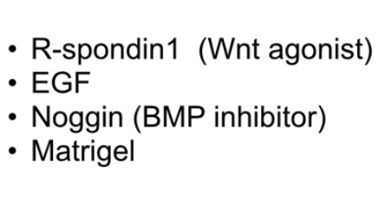
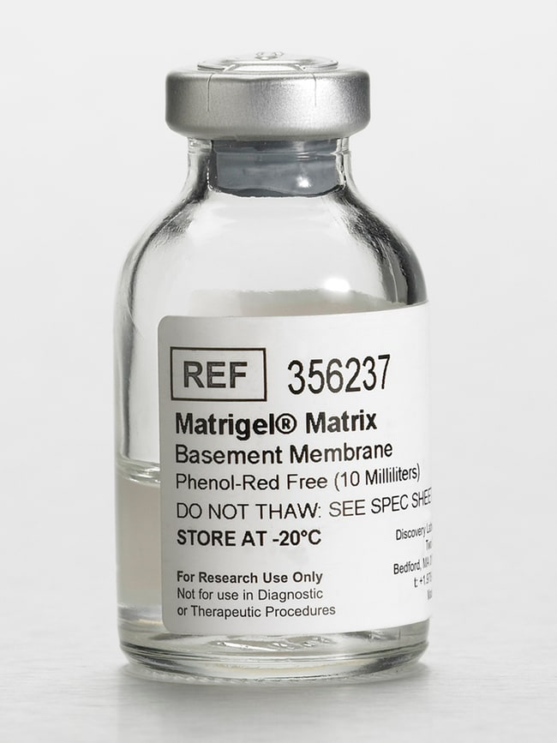
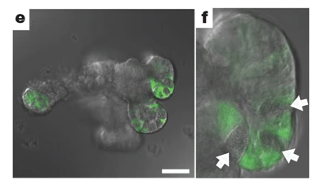
Органоиды тонкой кишки
Toshiro Sato
Sato T. et al. Single Lgr5 stem cells build crypt-villus structures in vitro without a mesenchymal niche //Nature. – 2009. – Т. 459. – №. 7244. – С. 262-265.

Slide 11
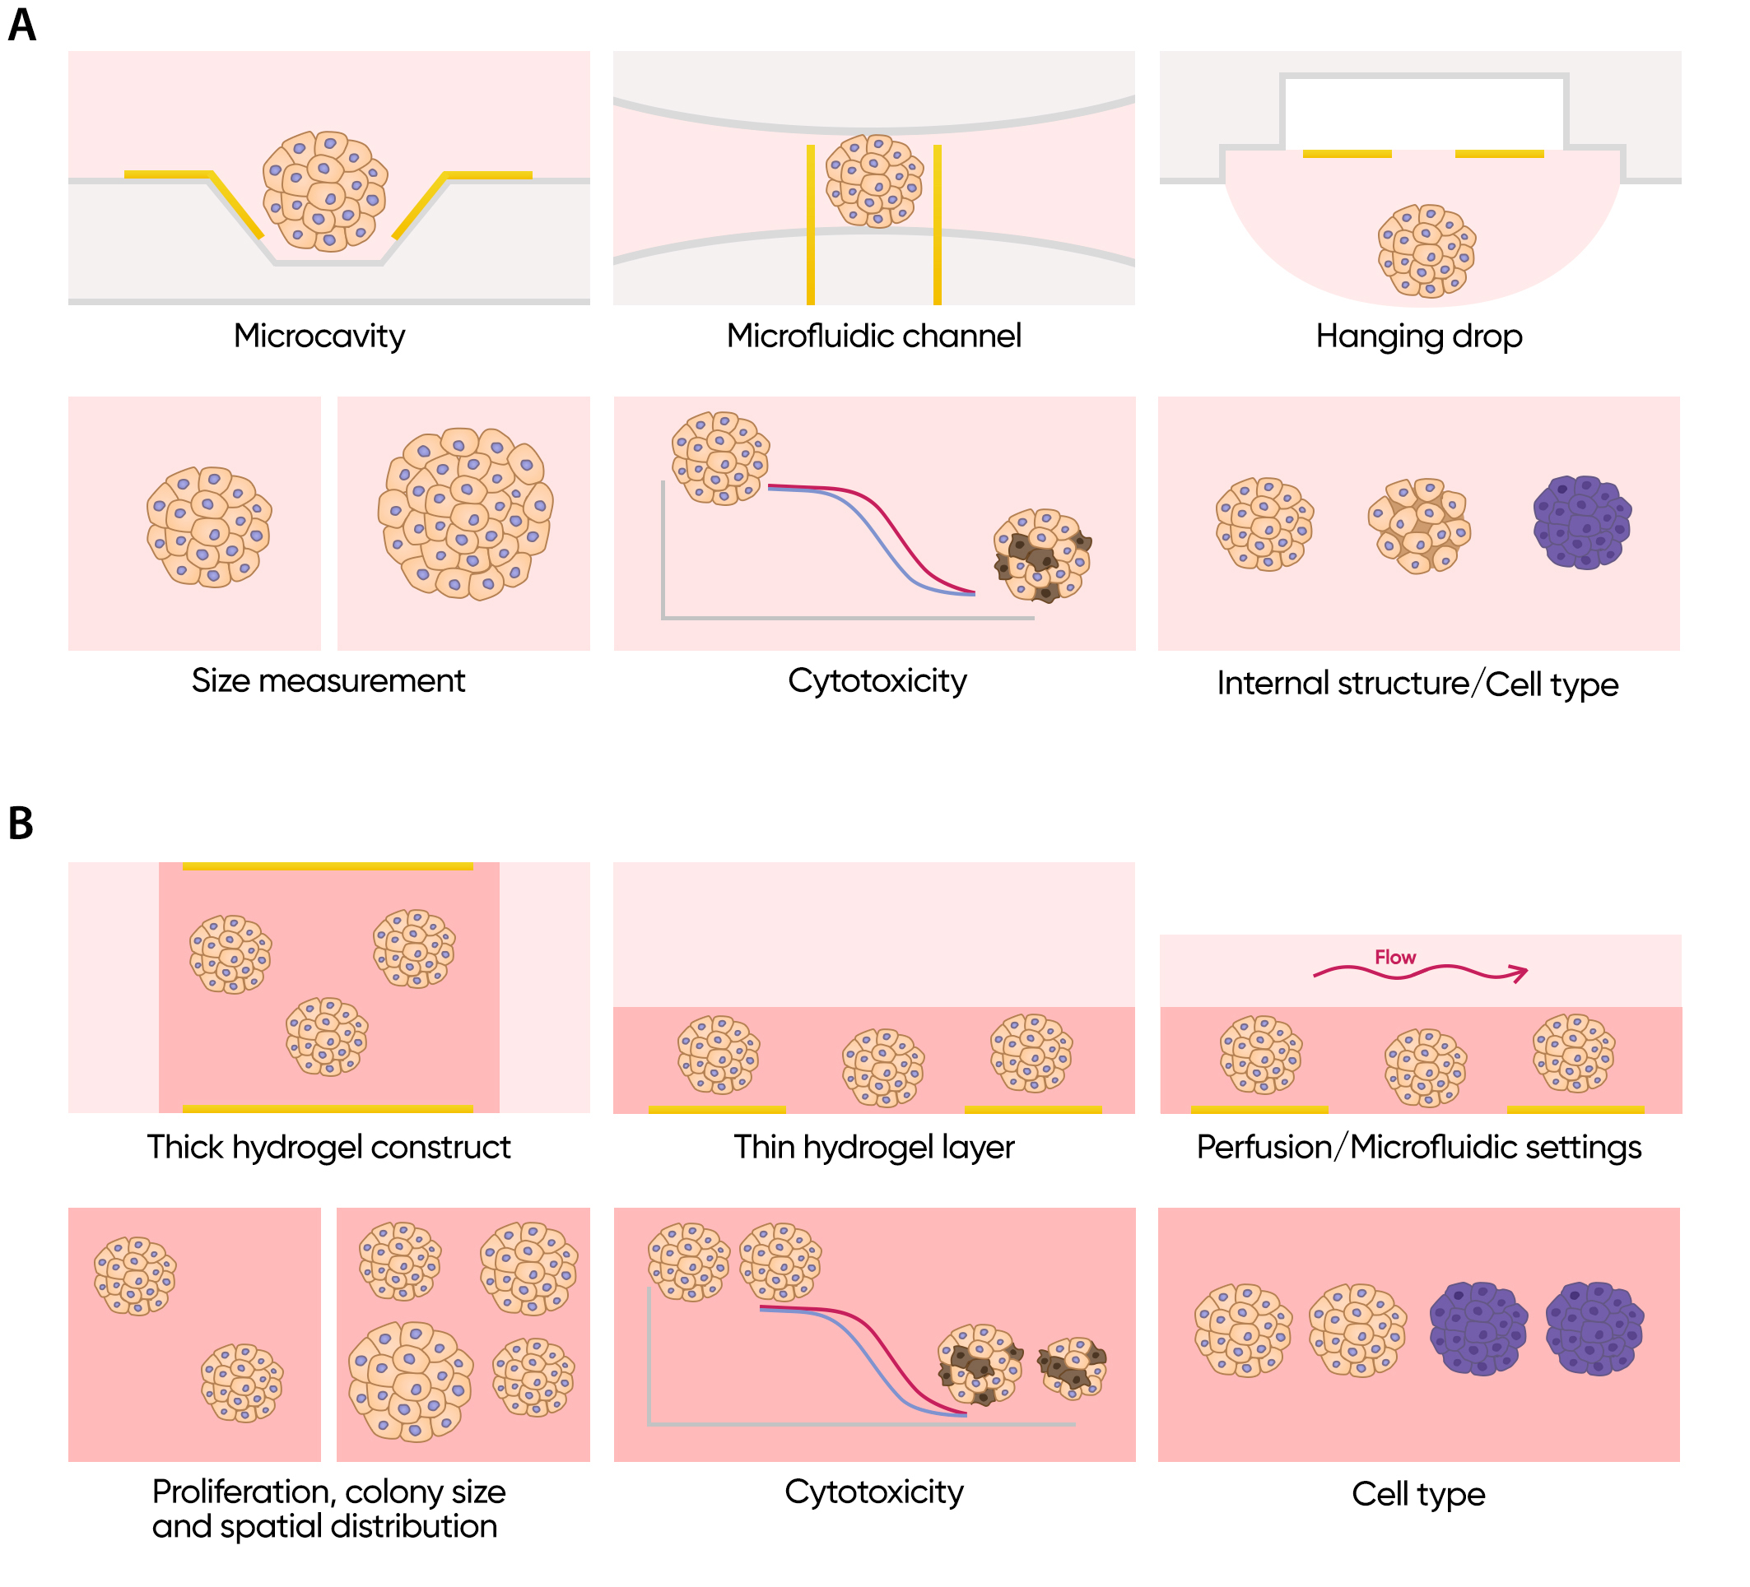
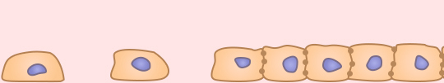
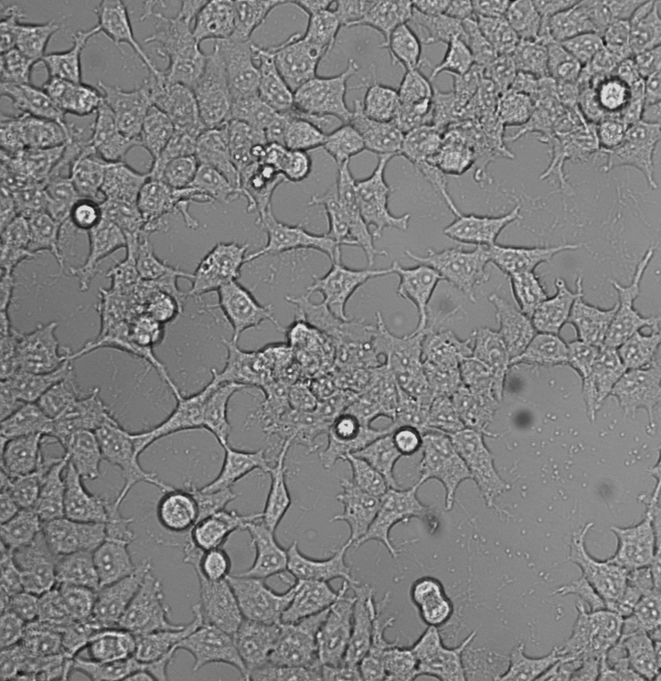
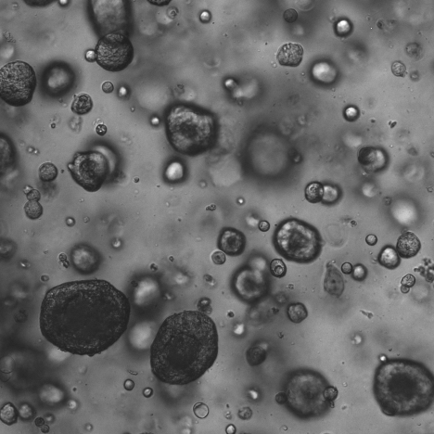
2D против 3D

Slide 12
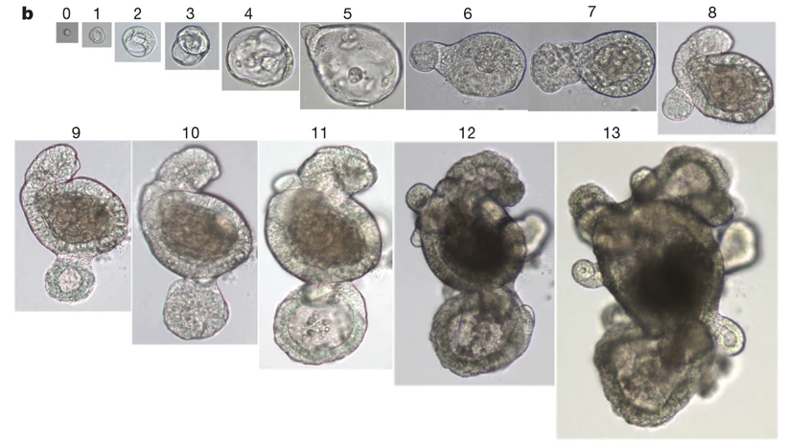
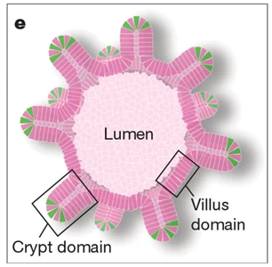
Органоиды тонкой кишки
Sato T. et al. Single Lgr5 stem cells build crypt-villus structures in vitro without a mesenchymal niche //Nature. – 2009. – Т. 459. – №. 7244. – С. 262-265.

Slide 13
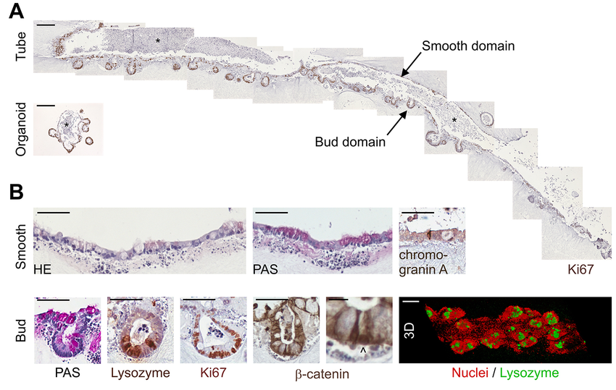
Слияние органоидов тонкой кишки
Sachs N. et al. Intestinal epithelial organoids fuse to form self-organizing tubes in floating collagen gels //Development. – 2017. – Т. 144. – №. 6. – С. 1107-1112.

Slide 14
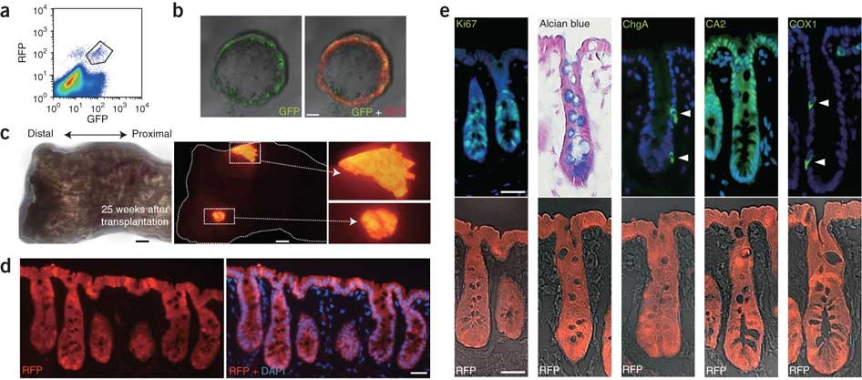
Трансплантация органоидов тонкой кишки
Yui S. et al. Functional engraftment of colon epithelium expanded in vitro from a single adult Lgr5+ stem cell //Nature medicine. – 2012. – Т. 18. – №. 4. – С. 618-623

Slide 15
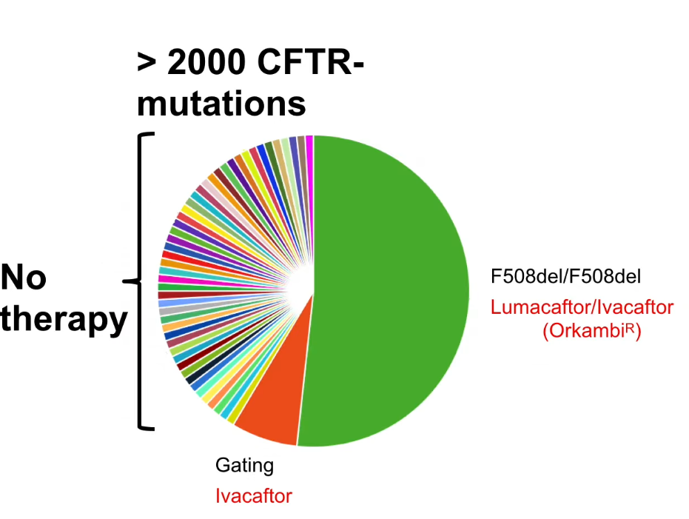
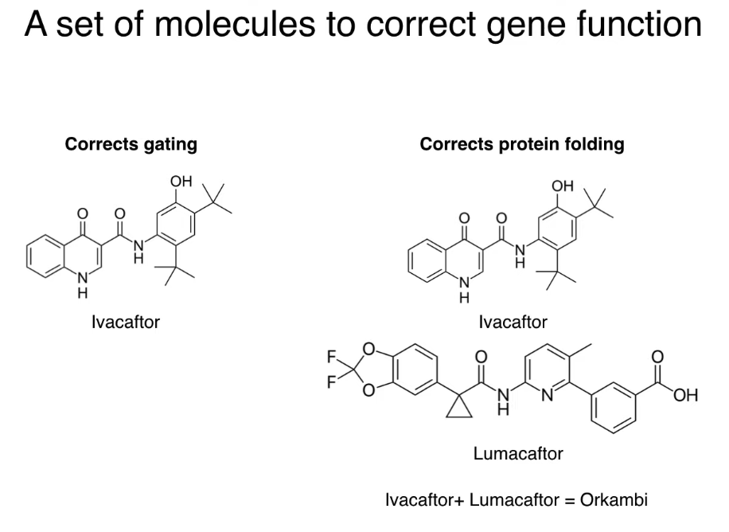
Применение органоидов при муковисцидозе

Slide 16
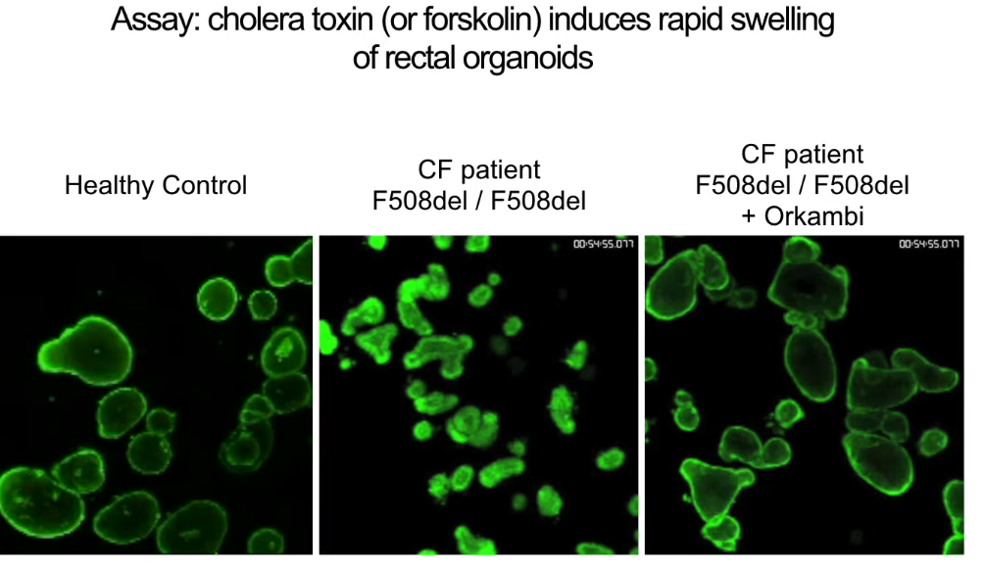
Применение органоидов при муковисцидозе
Dekkers J. F. et al. A functional CFTR assay using primary cystic fibrosis intestinal organoids //Nature medicine. – 2013. – Т. 19. – №. 7. – С. 939-945.

Slide 17
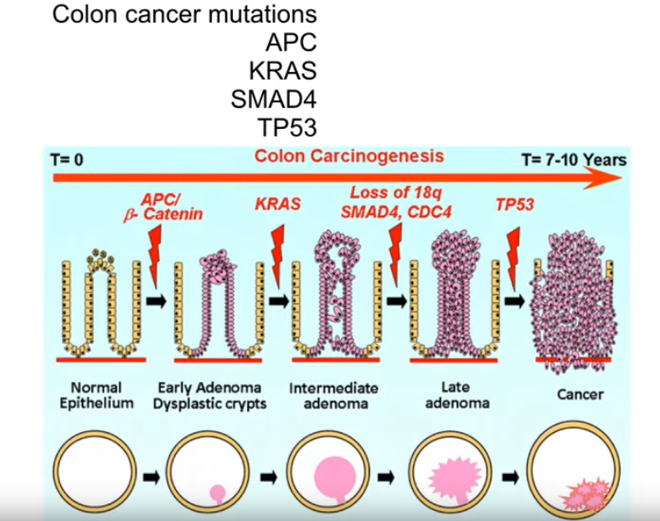
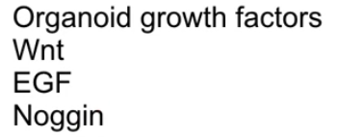
Прогрессия от аденомы к раку
Markle B., May E. J., Majumdar A. P. N. Do nutraceutics play a role in the prevention and treatment of colorectal cancer? //Cancer and metastasis reviews. – 2010. – Т. 29. – №. 3. – С. 395-404.

Slide 18
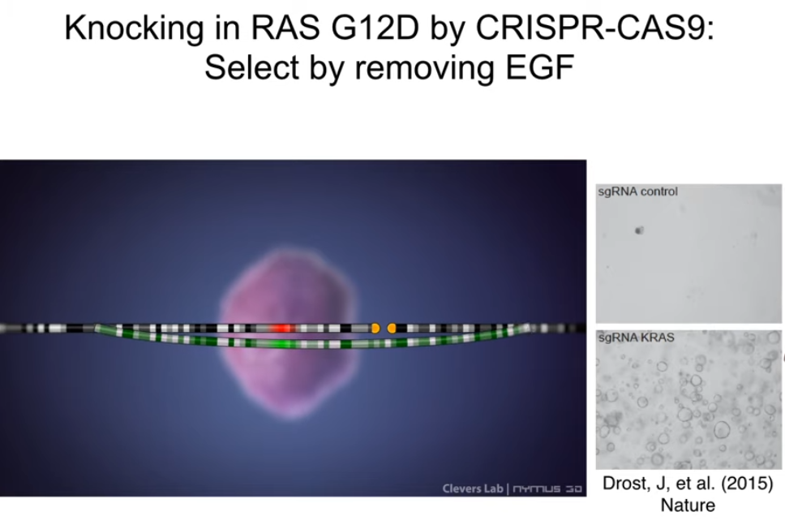
Прогрессия от аденомы к раку
Drost J. et al. Sequential cancer mutations in cultured human intestinal stem cells //Nature. – 2015. – Т. 521. – №. 7550. – С. 43-47.

Slide 19
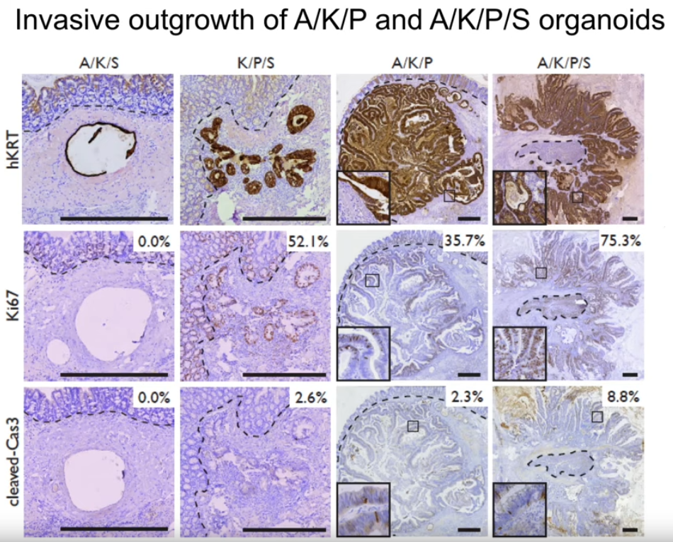
Прогрессия от аденомы к раку
Drost J. et al. Sequential cancer mutations in cultured human intestinal stem cells //Nature. – 2015. – Т. 521. – №. 7550. – С. 43-47.

Slide 20
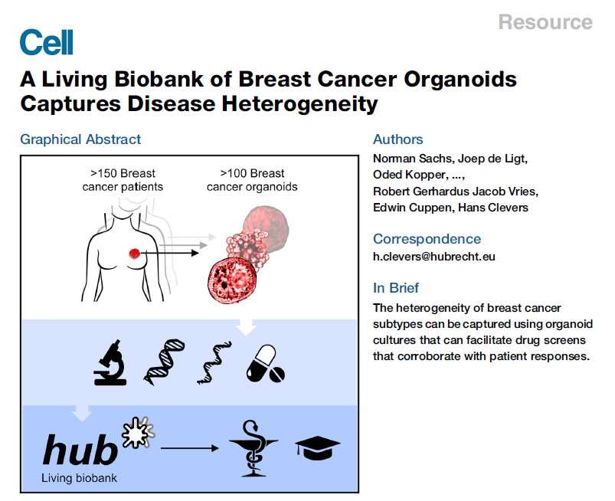
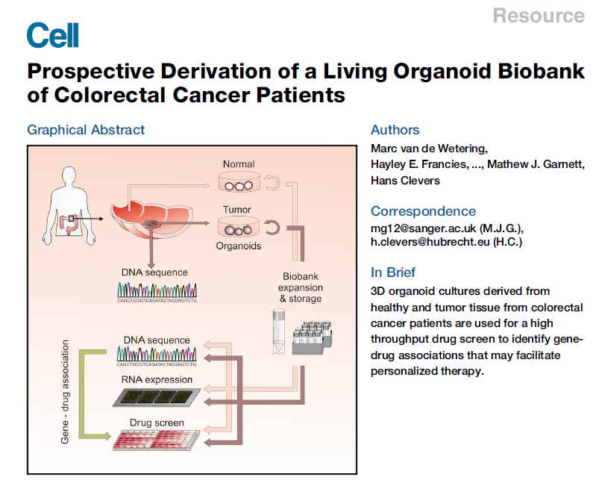
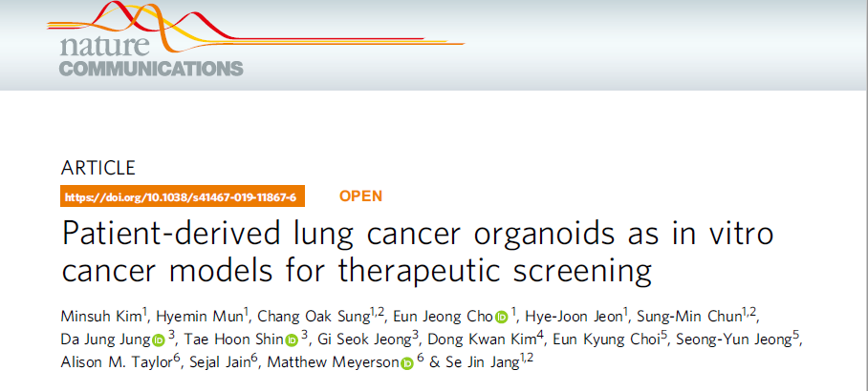
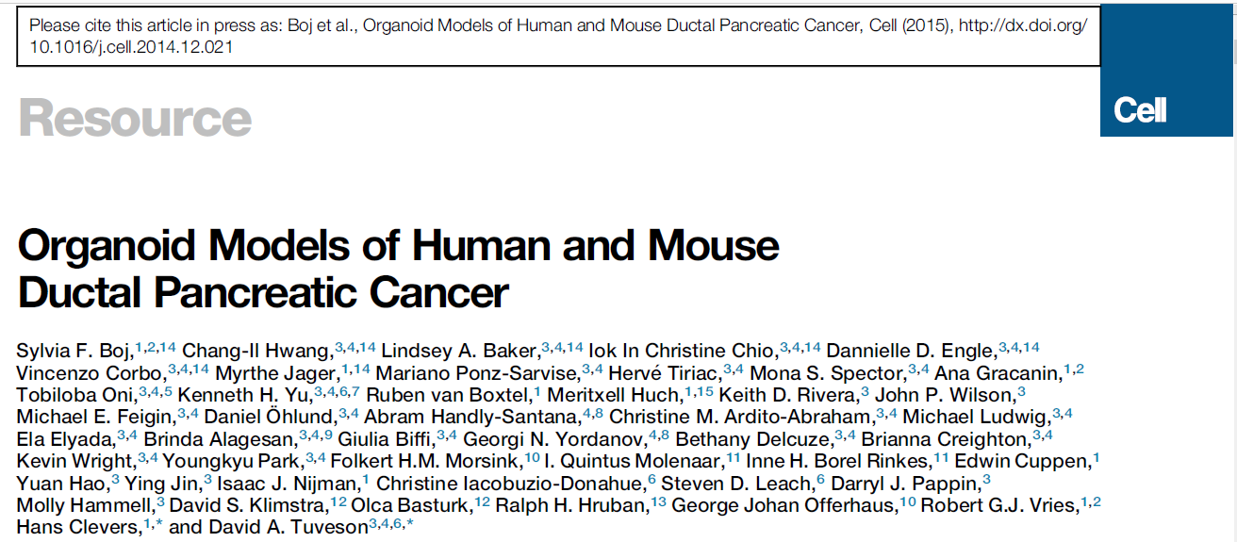
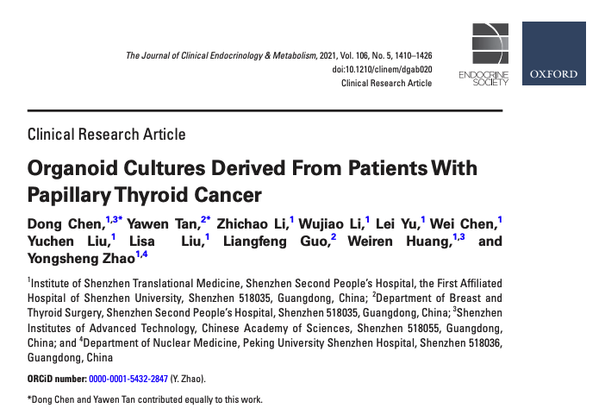
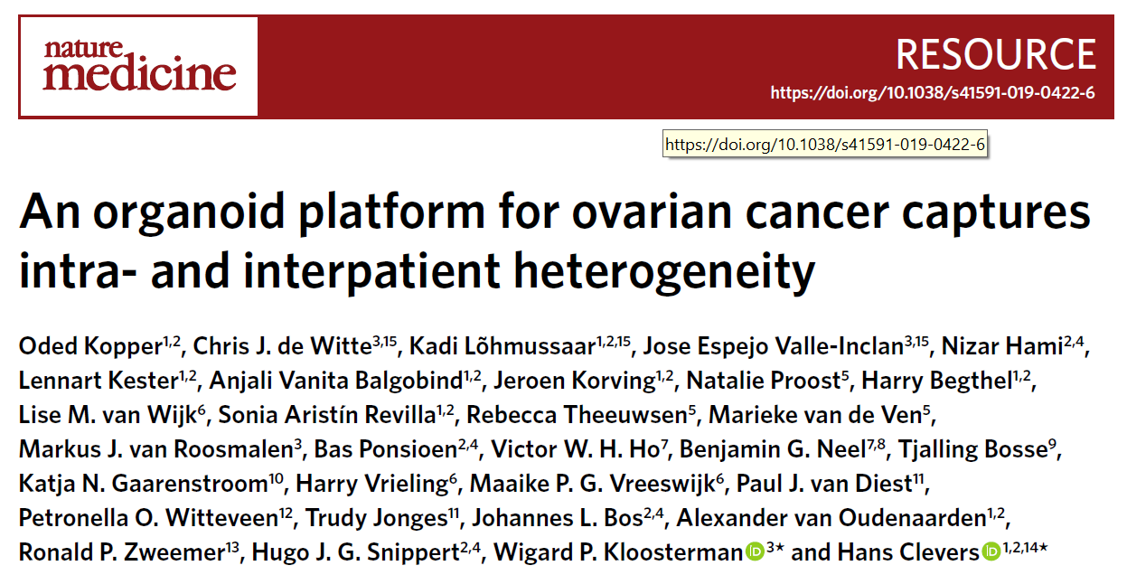
Опухолевые органоиды (тумороиды)

Slide 21
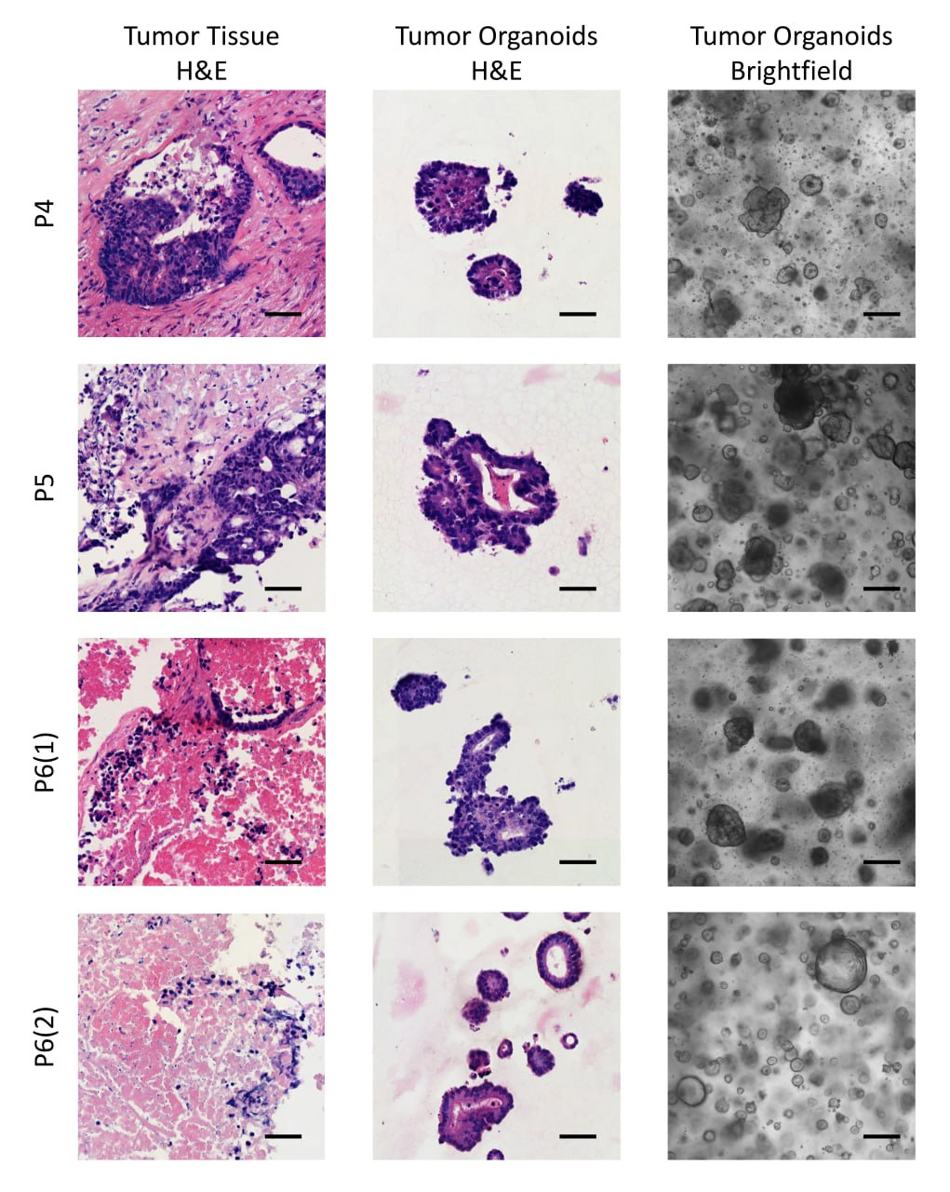
Опухолевые органоиды (тумороиды)
Razumovskaya, Alexandra, et al. "Predicting patient outcomes with gene-expression biomarkers from colorectal cancer organoids and cell lines." Frontiers in Molecular Biosciences 12 (2025): 1531175.

Slide 22
Опухолевые органоиды (тумороиды)
Poloznikov, Andrey, et al. "9-ING-41, a small molecule inhibitor of GSK-3β, potentiates the effects of chemotherapy on colorectal cancer cells." Frontiers in Pharmacology 12 (2021): 777114.

Slide 23
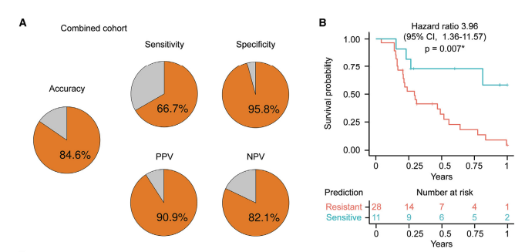
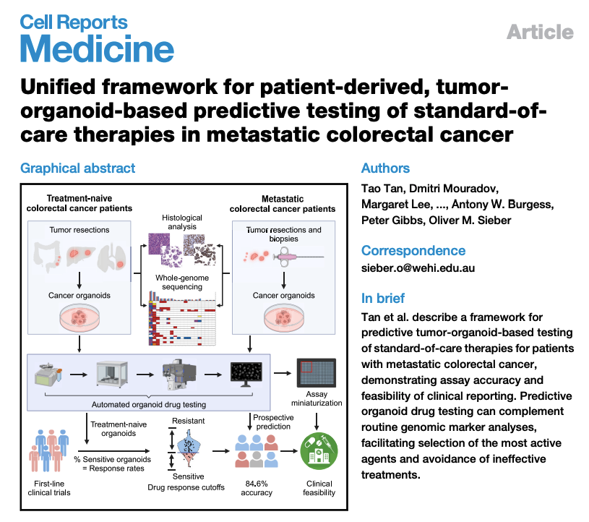
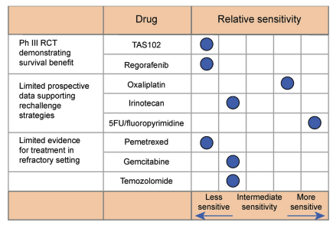
Клинические исследования

Slide 24
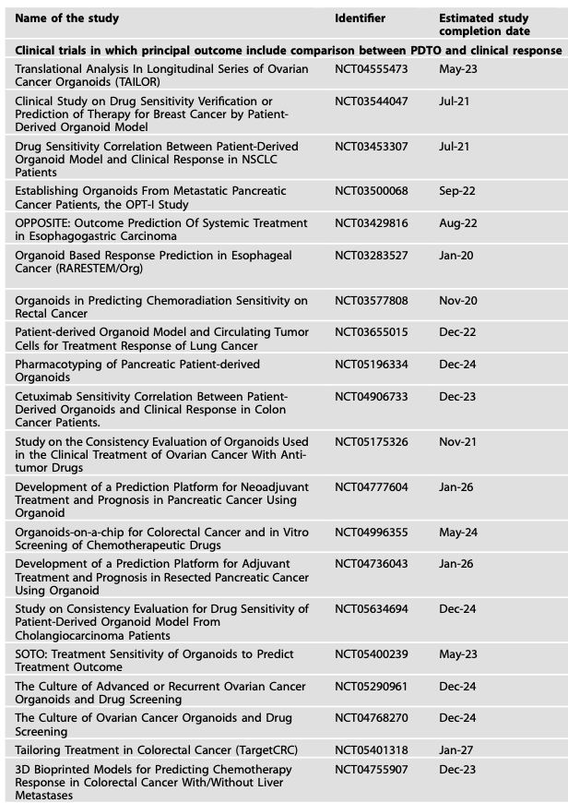
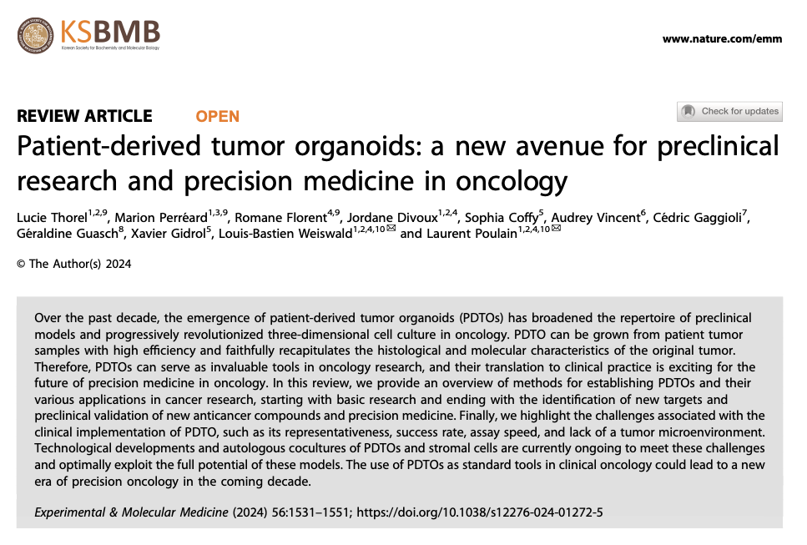
Клинические исследования

Slide 25
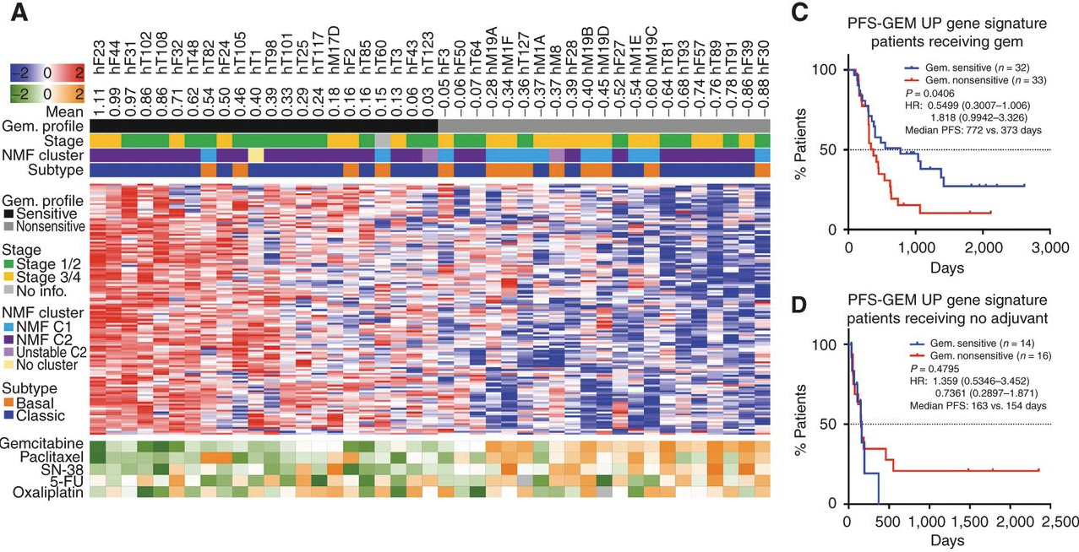
Биомаркеры
Tiriac, Hervé, et al. "Organoid profiling identifies common responders to chemotherapy in pancreatic cancer." Cancer discovery 8.9 (2018): 1112-1129.

Slide 26

Спасибо за внимание!
Москва, 2025 год

